Slide 1
The eBGP DFZ in 2011
Geoff Huston
APNIC

Slide 2
“Conventional “wisdom” about routing:
“The rapid and sustained growth of the Internet over the past
several decades has resulted in large state requirements for
IP routers. In recent years, these requirements are continuing
to worsen, due to increased deaggregation (advertising more specific
routes) arising from load balancing and security concerns..”
Quoted from a 2012 research paper on routing

Slide 3
“Conventional “wisdom” about routing:
“The rapid and sustained growth of the Internet over the past
several decades has resulted in large state requirements for
IP routers. In recent years, these requirements are continuing
to worsen, due to increased deaggregation (advertising more specific
routes) arising from load balancing and security concerns..”
quote from a 2012 research paper on routing
Is this really true, or do we accept it as true without actually looking at the real behaviours of the Internet’s routing system???

Slide 4
Agenda
In this presentation we will explore the space of inter-domain routing (the Border Gateway Protocol – BGP
  We will look at the growth of the eBGP routing table over time and some projections for future growth
  Then we’ll look at the extent to which more specifics are dominating routing table growth ... or not

Slide 5
The Big Picture of BGP Growth

Slide 6
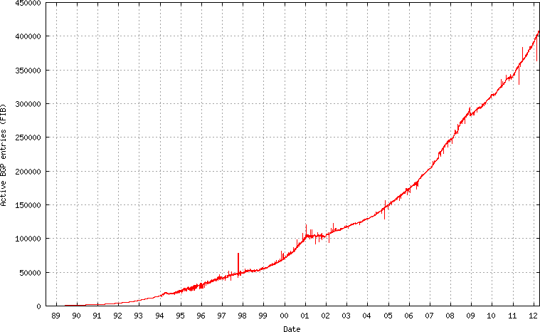
The Big Picture of the v4 Routing Table

Slide 7
The Big Picture of the v4 Routing Table
Address Exhaustion
The GFC hits the Internet
Broadband to the Masses
The Great Internet Boom
and Bust of 2000/2001
Introduction of
CIDR – March 1994

Slide 8
The Routing Table in 2010-2011
Lets look at the recent past in a little more detail...

Slide 9
IPv4 BGP Prefix Count 2010 - 2011
380,000
350,000
320,000
Jan
2010
Jul
2010
Jan
2011
Jul
2011
Jan
2012

Slide 10
IPv4 BGP Prefix Count 2010 - 2011
380,000
APNIC IPv4 runout day
350,000
Route Aggregation events
320,000
Jan
2010
Jul
2010
Jan
2011
Jul
2011
Jan
2012

Slide 11
IPv4 Routed Address Span
150/8s
140/8s
130/8s
Jan
2010
Jul
2010
Jan
2011
Jul
2011
Jan
2012
2010
2011

Slide 12
IPv4 Routed Address Span
150/8s
/8 advertisements (by RIRs)
140/8s
130/8s
Jan
2010
Jul
2010
Jan
2011
Jul
2011
Jan
2012
2010
2011

Slide 13
IPv4 Routed AS Count
39,000
36,000
33,000
Jan
2010
Jul
2010
Jan
2011
Jul
2011
Jan
2012
2010
2011

Slide 14
IPv4 2011 BGP Vital Statistics
Jan-11 Jan-12
Prefix Count 341,000 390,000 +14%
Roots 168,000 190,000 +13%
More Specifics 173,000 200,000 +15%
Address Span 140/8s 149/8s + 6%
AS Count 36,400 39,800 + 9%
Transit 5,000 5,700 +14%
Stub 31,400 34,100 + 9%

Slide 15
IPv4 in 2011
Overall Internet growth in terms of BGP is at a rate of some ~12% p.a.
  This is much the same as 2009 and 2010.
Table growth has slowed since 20 April 2011, following APINC’s IPv4 address run out
Address span growing more slowly than the table size (address consumption pressures evident?)
  But its picked up again in the first few months of 2012

Slide 16
IPv6 BGP Prefix Count
8,000
6,000
4,000
2,000
Jan
2010
Jul
2010
Jan
2011
Jul
2011
Jan
2012

Slide 17
IPv6 BGP Prefix Count
8,000
World IPv6 Day
6,000
4,000
2,000
Jan
2010
Jul
2010
Jan
2011
Jul
2011
Jan
2012

Slide 18
IPv6 Routed Address Span
16,000,000/32
10,000,000/32
2,000,000/32
Jan
2010
Jul
2010
Jan
2011
Jul
2011
Jan
2012

Slide 19
IPv6 Routed Address Span
Advertising a /8!
16,000,000/32
Advertising 2400::/12
10,000,000/32
2,000,000/32
Jan
2010
Jul
2010
Jan
2011
Jul
2011
Jan
2012

Slide 20
IPv6 Routed AS Count
5,000
4,000
3,000
2,000
Jan
2010
Jul
2010
Jan
2011
Jul
2011

Slide 21
IPv6 Routed AS Count
5,000
World IPv6 Day
4,000
3,000
2,000
Jan
2010
Jul
2010
Jan
2011
Jul
2011

Slide 22
IPv6 2011 BGP Vital Statistics
Jan-11 Jan-12 p.a. rate
Prefix Count 4,100 7,759 + 89%
Roots 3,178 5,751 + 81%
More Specifics 922 2,008 +118%
Address Span (/32s) 53,415 53,387 + 0%
AS Count 2,966 4,968 + 67%
Transit 556 985 + 77%
Stub 2,343 3,983 + 70%

Slide 23
IPv6 in 2010 - 2011
Overall IPv6 Internet growth in terms of BGP is 80% - 90 % p.a.
  2009 growth rate was ~ 50%.
(Looking at the AS count, if these relative growth rates persist then the IPv6 network would span the same network domain as IPv4 in 4 years time -- mid/late 2016)

Slide 24
BGP Size Projections
Generate a projection of the IPv4 routing table using a quadratic (O(2) polynomial) over the historic data
  For IPv4 this is a time of extreme uncertainty
    Registry IPv4 address run out
    Uncertainty over the impacts of any after-market in IPv4 on the routing table
  which makes this projection even more
  speculative than normal!

Slide 25
IPv4 Table Size
400,000
300,000
200,000
100,000
2004
2006
2008
2010
2012

Slide 26
Daily Growth Rates
200
IANA Exhaustion
100
0
GFC Mk1
-50
2004
2006
2008
2010
2012

Slide 27
Table Growth Model
400,000
549 year² – 2,171,288 year + 2,146,869,663
300,000
200,000
100,000
2004
2006
2008
2010
2012

Slide 28
IPv4 Table Projection
500,000
300,000
100,000
2004
2008
2012
2016

Slide 29
IPv4 BGP Table Size predictions
Jan 2011 347,000 entries
2012 390,000 entries
2013* 424,000 entries
2014* 463,000 entries
2015* 503,000 entries
2016* 545,000 entries
* These numbers are dubious due to uncertainties introduced by IPv4 address exhaustion pressures.

Slide 30
IPv6 Table Size
8,000
6,000
4,000
2,000
2007
2008
2009
2010
2011
2012

Slide 31
Daily Growth Rates
16
6,000
12
4,000
8
4
0
0
2007
2008
2009
2010
2011
2007
2008
2009
2010
2011
2012

Slide 32
IPv6 Table Projection
50,000
430 year² – 1,729,788 year + 1,736,733,880
40,000
e ** (0.469 * year - 934)
30,000
20,000
10,000
2007
2009
2011
2013
2015

Slide 33
IPv6 BGP Table Size predictions
Jan 2011 4,000 entries
2012 8,000 entries
2013 11,500 entries
2014 16,300 entries
2015 21,800 entries
2016 28,300 entries

Slide 34
Up and to the Right
Most Internet curves are “up and to the right”
But what makes this curve painful?
  The pain threshold is approximated by Moore’s Law

Slide 35
Moore’s Law
As a rough rule of thumb, if the rate of growth of the table grows at a rate equal to, or less than Moore’s Law, then the unit cost of storing the forwarding table should remain constant
  Like all rough rules of thumb, there are many potential exceptions, and costs have many inputs as well as the raw cost of the the number of gates in a chip
  Despite this, Moore’s Law still a useful benchmark of a threshold of concern about routing growth

Slide 36
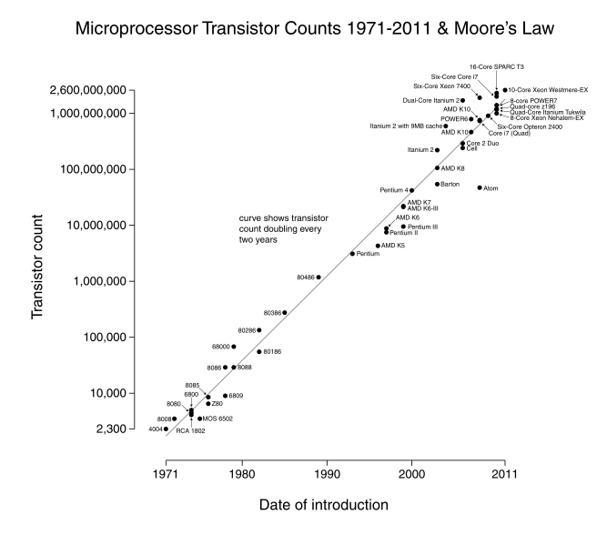

Slide 37
IPv4 BGP Table size and Moore’s Law
Moore’s Law
BGP Table Size Prediction

Slide 38
IPv6 Projections and Moore’s Law
Moore’s Law
BGP Table Size Predictions

Slide 39
eBGP Table Growth
Nothing in these figures suggests that there is cause for urgent alarm -- at present
The overall eBGP growth rates for IPv4 are holding at a modest level, and the IPv6 table, although it is growing rapidly, is still relatively small in size in absolute terms
As long as we are prepared to live within the technical constraints of the current routing paradigm it will continue to be viable for some time yet

Slide 40
BGP Table Growth
However ... continued scalability of the routing system relies on continued conservatism in routing practices.
How good are we at “being conservative” in routing?

Slide 41
CIDR and BGP
To what extent do we still practice “conservative” routing and refrain from announcing more specifics into the routing table?
Are we getting better or worse at aggregation in routing?
What is the distribution of advertising more specifics? Are we seeing a significant increase in the number of more specific /24s in the routing table?

Slide 42
An Example:
Prefix AS Path
193.124.0.0/15 4608 1221 4637 3356 20485 2118 ?
193.124.0.0/24 4608 1221 4637 3356 20485 2118 ?
193.124.1.0/24 4608 1221 4637 3356 20485 2118 ?
193.124.2.0/24 4608 1221 4637 3356 20485 2118 ?
193.124.3.0/24 4608 1221 4637 3356 20485 2118 ?
193.124.4.0/24 4608 1221 4637 3356 20485 2118 ?
193.124.5.0/24 4608 1221 4637 3356 20485 2118 ?
193.124.6.0/24 4608 1221 4637 3356 20485 2118 ?
193.124.7.0/24 4608 1221 4637 3356 20485 2118 ?
193.124.8.0/24 4608 1221 4637 3356 20485 2118 ?
193.124.9.0/24 4608 1221 4637 3356 20485 2118 ?
193.124.10.0/24 4608 1221 4637 3356 20485 2118 ?
193.124.11.0/24 4608 1221 4637 3356 20485 2118 ?
193.124.12.0/24 4608 1221 4637 3356 20485 2118 ?
193.124.13.0/24 4608 1221 4637 3356 20485 2118 ?
193.124.14.0/24 4608 1221 4637 3356 20485 2118 ?
193.124.15.0/24 4608 1221 4637 3356 20485 2118 ?
Origin AS: AS 2118 RELCOM-AS OOO "NPO Relcom"

Slide 43
Who is doing this the most?
www.cidr-report.org
--- 23Dec11 ---
ASnum NetsNow NetsAggr NetGain % Gain Description
Table 388637 227303 161334 41.5% All ASes
AS6389 3473 223 3250 93.6% BELLSOUTH-NET-BLK - BellSouth.net Inc.
AS18566 2093 412 1681 80.3% COVAD - Covad Communications Co.
AS4766 2492 990 1502 60.3% KIXS-AS-KR Korea Telecom
AS7029 2951 1521 1430 48.5% WINDSTREAM - Windstream Communications Inc
AS22773 1515 116 1399 92.3% Cox Communications Inc.
AS4755 1512 201 1311 86.7% TATACOMM-AS TATA Communications
AS4323 1622 387 1235 76.1% TWTC - tw telecom holdings, inc.
AS28573 1557 397 1160 74.5% NET Servicos de Comunicao S.A.
AS10620 1719 641 1078 62.7% Telmex Colombia S.A.
AS1785 1863 787 1076 57.8% AS-PAETEC-NET - PaeTec Communications, Inc.

Slide 44
BGP Routing Table

Slide 45
More specifics in the Routing Table
Since 2001 more specifics account for ~50% of the
Routing Table. This has been a relatively constant
Proportion.

Slide 46
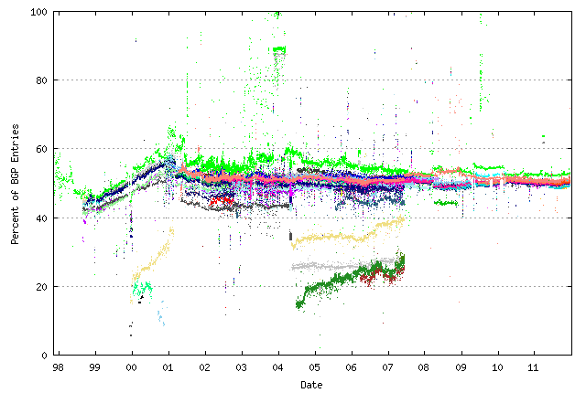
Does everyone see this?
% of entries that are more specific -- as seen by peers of Route Views

Slide 47
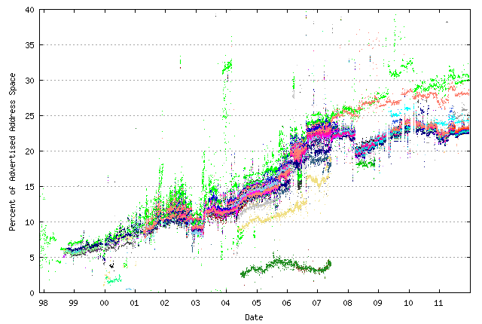
How much address space is announced by more specifics?
% of address space announced by more specifics –
as seen by peers of Route Views

Slide 48
Does everyone announce more specifics?

Slide 49
Is it Everyone?
3% of the ASes (1,186 ASes) announce 70% of the more specifics (136,023 announcements)
55% of the ASes announce no more specifics
The top 10 ASes announce 19,163 more specifics

Slide 50
The Top 10 of More Specifics
AS Aggregates More Specifics
6389 315 3155 BELLSOUTH-NET-BLK - BellSouth.net Inc.
7029 188 2770 WINDSTREAM - Windstream Communications
18566 25 2068 COVAD - Covad Communications Co.
4766 440 2043 KIX-AS-KR - Korea Telecom
1785 132 1731 AS-PAETEC-NET - PaeTec Communications
17974 44 1672 TELKOMNET-AS2-AP PT Telekomunikasi Indonesia
7545 78 1551 TPG-INTERNET-AP TPG Internet Pty Ltd
22773 118 1397 ASN-CXA-ALL-CCI-22773-RDC - Cox Communications
7552 31 1389 VIETEL-AS-AP Vietel Corporation
4755 127 1387 TATACOMM-AS TATA Communications

Slide 51
Are We Getting Any Better?
Take the daily top 10 Ases over the past 3 years and track the number of more specifics advertised by these Ases over the entire period

Slide 52
Yes ... and No

Slide 53
Are We Getting Any Better?
Some ASes are effectively reducing the number of more specifics that are advertised into the global routing system
Some ASes are increasing the number of more specifics
And some are consistently advertising a significant number of more specifics
There is no net change in the overall distribution and characteristics of more specifics in the routing system.

Slide 54
Why?
The reasons why we see more specifics in the routing system include:
  Different origination (“hole punching” in an aggregate)
  Traffic engineering of incoming traffic flows across multiple inter-AS paths
  “protection” against route hijacking by advertising more specifics
  Poor routing practices

Slide 55
Types of More Specifics

Slide 56
Types of More Specifics

Slide 57
Daily Update Rates
Do more specifics experience a higher update rate than aggregate advertisements?
Lets examine the past 3 years of updates and examine the average daily update per advertised prefix count for aggregates and more specifics

Slide 58
Daily Update Rates

Slide 59
Prefix Instability Rates

Slide 60
Daily Update Rates
Do more specifics experience a higher update rate than aggregate advertisements?
No!
This result is surprising – it was anticipated that more specifics would show a higher level of dynamic instability, particularly
relating to TE more specifics. However nothing is visible in the
data that supports this – advertised “root” prefixes are equally likely to be unstable as advertised more specific prefixes.

Slide 61
Problem? Not a Problem?
Its evident that the global BGP routing environment suffers from a certain amount of neglect and inattention
Could we do better?
  Yes!
Should we do better?
  It can be difficult to justify the effort and the cost: the current growth rates of the routing table lie within relatively modest parameters of growth and still sit within the broad parameters of constant unit cost of routing technology
  On the other hand, we need to recognize that we could do a lot better in terms of eliminating routing noise, and achieve this with with a relatively modest amount of effort

Slide 62
Thank You
Questions?

