Slide 1
Measuring DNSSEC
Geoff Huston & George Michaelson
APNICLabs
October 2012

Slide 2
What are the questions?
What proportion of DNS resolvers are DNSSEC-capable?
What proportion of users are using DNSSEC-validating DNS resolvers?
Where are these users?

Slide 3
Experimental Technique
Use code embedded in an online ad to perform two simple DNSSEC tests
GET http://t10000.u5950826831.s1347594696.i767.v6022.d.t5.dotnxdomain.net/1x1.png
GET http://t10000.u5950826831.s1347594696.i767.v6022.e.t6.dotnxdomain.net/1x1.png
1x1 pixel image
DNSSEC-signed domain
DNSSEC-signed subdomain
experiment type
unique experiment identifier string
(to eliminate interactions with caches)
Invalid DNSSEC signature chain
Valid DNSSEC signature chain

Slide 4
The Experiment
Embed the unique id generation and the ad control in flash code
  Use a 10 second timer to POST results to the server
Enrol an online advertisement network to display the ad
The underlying code and the retrieval of the image is executed as part of the ad display function
  No click is required!
    (or wanted!)

Slide 5
Experiment Run
10 – 27 September 2012
2,831,780 experiments were executed

Slide 6
DNSSEC-Validating Resolver
23-Sep-2012 00:09:40.747 queries: client 201.6.x.y#28672:
query: t10000.u356944218.s1348355380.i767.v6022.d.t5.dotnxdomain.net IN A -EDC (203.133.248.110)
23-Sep-2012 00:09:41.118 queries: client 201.6.x.y#11321:
query: t5.dotnxdomain.net IN DNSKEY -EDC (203.133.248.6)
23-Sep-2012 00:09:41.494 queries: client 201.6.x.y#59852:
query: t5.dotnxdomain.net IN DS -EDC (203.133.248.110)
1. x.y.z A?
2. x.y.z A?
Client
DNS Resolver
3. y.z DNSKEY?
4. y.z DS?
5. x.y.z A=addr
DNSSEC validation queries

Slide 7
DNS Resolvers
How many unique IP addresses queried for experiment domains in dotnxdomain.net?
How many of these DNS resolvers also queried for the DNSKEY RR of dotnxdomain.net?

Slide 8
DNS Resolvers
How many unique IP addresses queried for experiment domains in dotnxdomain.net?
  126,780
How many of these DNS resolvers also queried for the DNSKEY RR of dotnxdomain.net?
  3,367

Slide 9
Q1: What proportion of DNS resolvers are DNSSEC-capable?
2.6% of visible DNS resolvers appear to be performing DNSSEC validation

Slide 10
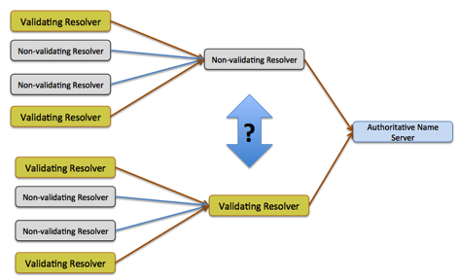
Hang on...
How can we tell the difference between a DNSSEC-capable DNS recursive resolver and a DNS forwarder?

Slide 11
Hang on...
How can we tell the difference between a DNSSEC-capable DNS recursive resolver and a DNS forwarder?
  Look for a DNSKEY query within 3 seconds of the initial DNS query. If the DNSKEY query “follows” the initial query within 3 seconds it is more likely we are seeing a DNSSEC-validating DNS recursive resolver.

Slide 12
A DNSSEC-validating resolver will perform validation as part of the query resolution
process. This implies that the resolver will submit a DNSKEY query “very soon” after
the first A query.
So if we look at the time gap between the first A query and the first DNSKEY query we
might be able to distinguish between recursive resolvers and forwarders

Slide 13
Resolvers:
How many unique IP addresses queried for experiment domains in dotnxdomain.net?
  126,780
How many of these DNS resolvers also (immediately) queried for the DNSKEY RR of dotnxdomain.net?
  2,277
  Thats 1.7% of the seen resolver set

Slide 14
Hang on again...
We are getting each client to fetch two URLs:
  One is DNSSEC-valid
  One is not
If a client fetches the DNSSEC-invalid URL _and_ if the only resolver used by the client is a supposedly DNSSEC-validating recursive resolver then we can infer that the resolver is not in fact a DNSSEC-validating recursive resolver

Slide 15
Resolvers:
How many unique IP addresses queried for experiment domains in dotnxdomain.net?
  126,780
How many of these DNS resolvers also (immediately) queried for the DNSKEY RR of dotnxdomain.net AND returned an error for DNSSEC-invalid queries?
  2,123
  That’s 1.6% of the seen DNS resolver set

Slide 16
Infrastructure Resolvers:
Filter out all resolvers that are associated with just 10 or fewer end clients
How many “big” resolvers are left: 26,825
How many perform DNSSEC validation: 819
What’s the DNSSEC-active proportion of these resolvers: 3.1%

Slide 17
“small scale” Resolvers
How many “small” resolvers were seen: 68,806
How many perform DNSSEC validation: 692
What’s the DNSSEC-active proportion of these resolvers: 1.0%

Slide 18
The Biggest Resolvers by Origin AS
DNSSEC? Clients AS AS NAME
Country
no 976241 AS4766 KIXS-AS-KR Korea Telecom Republic of Korea
no 472735 AS15169 GOOGLE - Google Inc. USA
no 411220 AS16880 TRENDMICRO Global IDC and Backbone of Trend Micro USA
no 330663 AS3462 HINET Data Communication Business Group Taiwan
no 294053 AS3786 LGDACOM LG DACOM Corporation Republic of Korea
no 274418 AS5384 EMIRATES-INTERNET Emirates Telecommunications Corp United Arab Emirates
no 228905 AS4134 CHINANET-BACKBONE No.31,Jin-rong Street China
no 194865 AS9318 HANARO-AS Hanaro Telecom Inc. Republic of Korea
no 145429 AS4837 CHINA169-BACKBONE CNCGROUP China169 Backbone China
yes 140211 AS7922 COMCAST-7922 - Comcast Cable Communications, Inc. USA
no 120056 AS4788 TMNET-AS-AP TM Net, Internet Service Provider Malaysia
no 113965 AS3356 LEVEL3 Level 3 Communications USA
no 107524 AS9050 RTD ROMTELECOM S.A Romania
no 100527 AS45595 PKTELECOM-AS-PK Pakistan Telecom Company Limited Pakistan
no 87825 AS6799 OTENET-GR Ote SA (Hellenic Telecommunications Orga Greece
no 86182 AS7470 TRUEINTERNET-AS-AP TRUE INTERNET Co.,Ltd. Thailand
no 85917 AS17676 GIGAINFRA Softbank BB Corp. Japan
no 83349 AS4713 OCN NTT Communications Corporation Japan
no 82349 AS25019 SAUDINETSTC-AS Autonomus System Number for SaudiNe Saudi Arabia
no 82146 AS8781 QA-ISP Qatar Telecom (Qtel) Q.S.C. Qatar
no 78339 AS9737 TOTNET-TH-AS-AP TOT Public Company Limited Thailand
no 75510 AS9299 IPG-AS-AP Philippine Long Distance Telephone Compa Philippines
no 71499 AS15557 LDCOMNET Societe Francaise du Radiotelephone S.A France
no 69071 AS45758 TRIPLETNET-AS-AP TripleT Internet Internet service Thailand
no 67079 AS8452 TE-AS TE-AS Egypt

Slide 19
The Biggest DNSSEC-validating Resolvers by Origin AS
DNSSEC? Clients AS AS NAME
Country
yes 140211 AS7922 COMCAST-7922 - Comcast Cable Communications, Inc. USA
yes 11355 AS5466 EIRCOM Eircom Limited Ireland
yes 9804 AS9299 IPG-AS-AP Philippine Long Distance Telephone Compa Philippines
yes 9327 AS3301 TELIANET-SWEDEN TeliaSonera AB Sweden
yes 9005 AS22047 VTR BANDA ANCHA S.A. Chile
yes 7390 AS16276 OVH OVH Systems France
yes 5313 AS28573 NET Servicos de Comunicao S.A. Brazil
yes 4758 AS1257 TELE2 European Union
yes 3762 AS7657 VODAFONE-NZ-NGN-AS Vodafone NZ Ltd. New Zealand
yes 3684 AS23700 BM-AS-ID PT. Broadband Multimedia, Tbk Indonesia
yes 3649 AS5713 SAIX-NET South Africa
yes 3448 AS15735 DATASTREAM-NET GO p.l.c. Malta
yes 3411 AS2519 VECTANT VECTANT Ltd. Japan
yes 3177 AS29562 KABELBW-ASN Kabel BW GmbH Germany
yes 2927 AS4134 CHINANET-BACKBONE No.31,Jin-rong Street China
yes 2180 AS28725 CZ-EUROTEL-AS AS of Eurotel Praha Czech Republic
yes 1897 AS39651 COMHEM-SWEDEN Com Hem Sweden Sweden
yes 1849 AS11992 CENTENNIAL-PR - Centennial de Puerto Rico Puerto Rico
yes 1832 AS12912 ERA Polska Telefonia Cyfrowa S.A. Poland
yes 1809 AS12301 INVITEL Invitel Tavkozlesi Zrt. Hungary
yes 1798 AS11814 DISTRIBUTEL-AS11814 - DISTRIBUTEL COMMUNICATIONS L Canada
yes 1781 AS2119 TELENOR-NEXTEL Telenor Norge AS Norway
yes 1444 AS34779 T-2-AS AS set propagated by T-2, d.o.o. Slovenia
yes 1220 AS44034 HI3G Hi3G Access AB Sweden
yes 947 AS23752 NPTELECOM-NP-AS Nepal Telecommunications Corporati Nepal

Slide 20
Now lets look at Clients:
How many unique IP addresses completed web fetches for objects named in the experiment?
How many clients exclusively used DNSSEC-validating resolvers?

Slide 21
Clients:
How many unique IP addresses completed web fetches for objects named in the experiment?
  1,717,906
How many clients exclusively used DNSSEC-validating resolvers?
27,838

Slide 22
Q2: What proportion of users are DNSSEC-validating resolvers?
1.6% of end client systems are using only DNS resolvers that appear to be performing DNSSEC validation

Slide 23
Q3: Where can we find DNSSEC-validating clients?

Slide 24
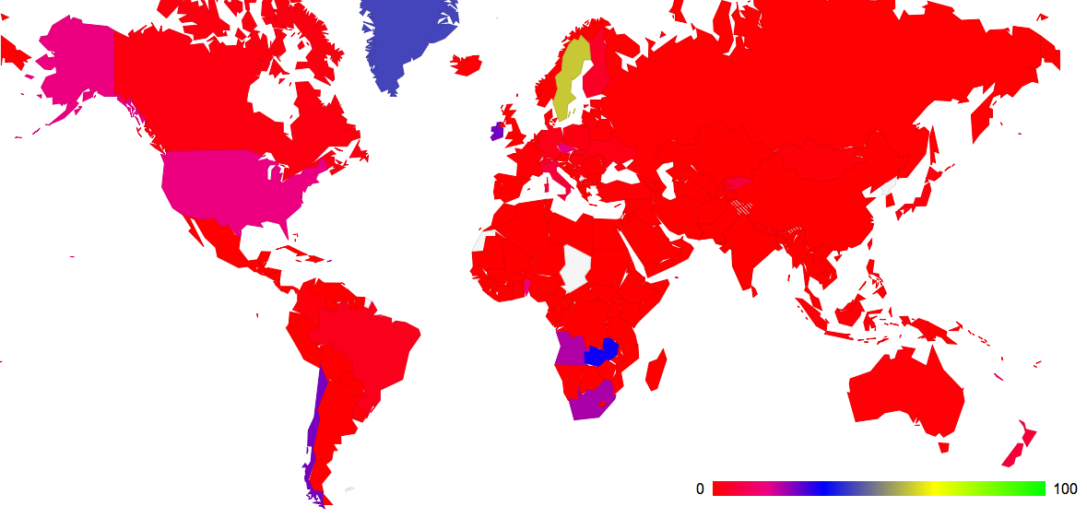
Q3: Where can we find DNSSEC-validating clients?
Client use of DNSSEC by country (%)
September 2012

Slide 25
The top of the country list
63.44% AG 177 279 Antigua and Barbuda
59.48% SE 1982 3332 Sweden
42.31% GL 11 26 Greenland
32.31% ZM 158 489 Zambia
25.17% IE 1632 6484 Ireland
24.88% CL 2068 8313 Chile
21.95% PR 570 2597 Puerto Rico
21.40% ZA 782 3655 South Africa
20.88% AO 62 297 Angola
16.00% BB 135 844 Barbados
15.75% US 9149 58074 United States of America
15.66% BJ 13 83 Benin
14.74% CZ 858 5820 Czech Republic
8.00% NC 16 200 New Caledonia
7.07% NZ 569 8045 New Zealand
6.85% KG 23 336 Kyrgyzstan
6.79% IT 1917 28228 Italy
6.63% LB 62 935 Lebanon
4.82% MT 171 3545 Malta
4.69% FI 93 1981 Finland
3.75% CH 171 4562 Switzerland
3.37% BR 1411 41906 Brazil
3.03% LI 1 33 Liechtenstein
2.83% DE 484 17105 Germany
2.09% UA 329 15711 Ukraine
% who
validate
DNSSEC
Validate
DNSSEC
Total

Slide 26
The top of the country list
59.48% SE 1982 3332 Sweden
25.17% IE 1632 6484 Ireland
24.88% CL 2068 8313 Chile
21.95% PR 570 2597 Puerto Rico
21.40% ZA 782 3655 South Africa
15.75% US 9149 58074 United States of America
14.74% CZ 858 5820 Czech Republic
7.07% NZ 569 8045 New Zealand
6.79% IT 1917 28228 Italy
4.82% MT 171 3545 Malta
4.69% FI 93 1981 Finland
3.75% CH 171 4562 Switzerland
3.37% BR 1411 41906 Brazil
2.83% DE 484 17105 Germany
2.09% UA 329 15711 Ukraine
1.98% CA 543 27405 Canada
1.97% SK 62 3140 Slovakia
1.89% PL 799 42284 Poland
1.65% HU 255 15432 Hungary
1.65% JP 792 48089 Japan
1.41% UY 35 2485 Uruguay
1.21% LT 105 8658 Lithuania
1.15% CO 73 6331 Colombia
1.15% SI 41 3573 Slovenia
1.11% RS 133 11963 Serbia
0.94% ID 308 32891 Indonesia
0.78% TR 91 11656 Turkey
% who
validate
DNSSEC
Validate
DNSSEC
Total
Ranking only those CCs with more than 1000 sample points in this experiment run (106 CC’s)

Slide 27
The bottom of the country list
59.48% SE 1982 3332 Sweden
25.17% IE 1632 6484 Ireland
24.88% CL 2068 8313 Chile
21.95% PR 570 2597 Puerto Rico
21.40% ZA 782 3655 South Africa
15.75% US 9149 58074 United States of America
14.74% CZ 858 5820 Czech Republic
7.07% NZ 569 8045 New Zealand
6.79% IT 1917 28228 Italy
4.82% MT 171 3545 Malta
4.69% FI 93 1981 Finland
3.75% CH 171 4562 Switzerland
3.37% BR 1411 41906 Brazil
2.83% DE 484 17105 Germany
2.09% UA 329 15711 Ukraine
1.98% CA 543 27405 Canada
1.97% SK 62 3140 Slovakia
1.89% PL 799 42284 Poland
1.65% HU 255 15432 Hungary
1.65% JP 792 48089 Japan
1.41% UY 35 2485 Uruguay
1.21% LT 105 8658 Lithuania
1.15% CO 73 6331 Colombia
1.15% SI 41 3573 Slovenia
1.11% RS 133 11963 Serbia
0.94% ID 308 32891 Indonesia
0.78% TR 91 11656 Turkey
Validate
DNSSEC
% who
validate
DNSSEC
Validate
DNSSEC
% who
validate
DNSSEC
Total
Total
0.01% GR 6 70060 Greece
0.01% SA 3 36156 Saudi Arabia
0.01% CY 1 11523 Cyprus
0.00% AE 0 28475 United Arab Emirates
0.00% QA 0 16413 Qatar
0.00% LK 0 10401 Sri Lanka
0.00% DZ 0 6574 Algeria
0.00% KW 0 6192 Kuwait
0.00% OM 0 4317 Oman
0.00% KZ 0 4153 Kazakhstan
0.00% JO 0 4177 Jordan
0.00% EC 0 3868 Ecuador
0.00% BH 0 3135 Bahrain
0.00% YE 0 2526 Yemen
0.00% MO 0 2287 Macao
0.00% PS 0 2321 Occupied Palestine
0.00% MU 0 2098 Mauritius
0.00% LV 0 1945 Latvia
0.00% PA 0 1617 Panama
0.00% NG 0 1394 Nigeria
0.00% ZW 0 1392 Zimbabwe
0.00% SD 0 1273 Sudan
0.00% ME 0 1244 Montenegro
0.00% SV 0 1182 El Salvador
0.00% GT 0 1127 Guatemala
0.00% TT 0 1058 Trinidad and Tobago
0.00% JM 0 1088 Jamaica
Ranking only those CCs with more than 1000 sample points in this experiment run (106 CC’s)

Slide 28
DNSSEC-Validating Clients by AS – the top AS’s
% who
validate
DNSSEC
Validate
DNSSEC
Total
97.54% AS44143 119 122 RS VIPMOBILE-AS Vip mobile d.o.o., Serbia
97.26% AS27831 71 73 CO Colombia M?vil, Colombia
97.03% AS44034 261 269 SE HI3G Hi3G Access AB, Sweden
96.83% AS28725 61 63 CZ CZ-EUROTEL-AS AS of Eurotel Praha, Czech Republic
96.49% AS15600 55 57 CH FINECOM Finecom Telecommunications AG, Switzerland
96.26% AS20776 180 187 FR OUTREMER-AS Outremer Telecom, France
94.93% AS12912 712 750 PL ERA Polska Telefonia Cyfrowa S.A., Poland
94.30% AS31343 248 263 UA INTERTELECOM Intertelecom Ltd, Ukraine
91.87% AS29518 113 123 SE BREDBAND2 Bredband2 AB, Sweden
90.86% AS5466 1631 1795 IE EIRCOM Eircom Limited, Ireland
90.79% AS38484 69 76 AU VIRGIN-BROADBAND-AS-AP Virgin Broadband VISP, Australia
88.06% AS22047 2066 2346 CL VTR BANDA ANCHA S.A., Chile
87.83% AS11992 570 649 PR CENTENNIAL-PR - Centennial de Puerto Rico, Puerto Rico
87.74% AS3737 93 106 US PTD-AS - PenTeleData Inc., United States of America
87.40% AS17711 111 127 TW NDHU-TW National Dong Hwa University, Taiwan
86.25% AS3301 508 589 SE TELIANET-SWEDEN TeliaSonera AB, Sweden
85.19% AS3245 46 54 BG DIGSYS-AS Digital Systems Ltd, Bulgaria
83.78% AS41833 62 74 LB MOSCANET Moscanet (WISE), Lebanon
82.26% AS8473 102 124 SE BAHNHOF Bahnhof Internet AB, Sweden
80.43% AS7922 8855 11010 US COMCAST-7922 - Comcast Cable Communications, Inc., United States of America
80.27% AS4704 118 147 JP SANNET SANYO Information Technology Solutions Co., Ltd., Japan
80.09% AS5713 744 929 ZA SAIX-NET, South Africa
80.00% AS41749 100 125 RO NETCOMPUTERS-AS Net & Computers SRL, Romania
79.44% AS24852 85 107 LT VINITA VINITA Internet Services, Lithuania
76.16% AS1257 409 537 EU TELE2, European Union
Ranking only those ASs with more than 50 sample points in this experiment run (15,134 AS’s)

Slide 29
The Sort-of-Good News
1.6% of clients appear to use DNSSEC-validating resolvers - that’s almost twice the amount DNSSEC validation coverage for the Internet than the amount of users who have IPv6!

Slide 30

And finally...
The “Mad Resolver” prize goes to the pair of resolvers:
  217.73.15.39
  217.73.15.38
who successfully queried for the same A RR from our server for a total of 93,237 times over eight hours
  Thanks guys! Great achievement!

Slide 31
Thank you!

